Slide 1




Linux tools
Mag Selwa, Geert Jan Bex
ICTS Leuven

Slide 2
Overview
Few important issues: quotes, pipes, redirections, output
Some useful commands
Grep
Sed
Awk
Gnuplot
ImageMagick

Slide 3
Objectives
The material in this lecture is not a complete guide or manual.
The purpose is to get overview of the capabilities of the different tools and to underline their particular strengths and disadvantages.
The course aims to promote the tools for use in your every day research work and urges you find solutions yourself rather than expecting a complete solution.

Slide 4
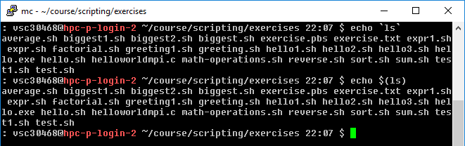
Difference Between Single, Double, and Backwards Quote
Single quotes (‘) do not interpret any variables
Double quotes (“) interpret variables
Backwards quotes (`) interpret variables and treat them as a program to run and return the results of that program
These two operators do the same thing. Compare these two lines: `` vs $()

Slide 5
<() vs $()
<() is similar to $() in that the output of the command inside is re-used.
In this case, though, the output is treated as a file. This file can be used as an argument to commands that take files as an argument.
Try:
$ grep somestring file1 > /tmp/a
$ grep somestring file2 > /tmp/b
$ diff /tmp/a /tmp/b
instead you can write:
$ diff <(grep somestring file1) <(grep somestring file2)

Slide 6
Quote characters
There are three different quote characters with different behaviour. These are:
“ : double quote, weak quote. If a string is enclosed in “ ” the references to variables (i.e $variable ) are replaced by their values. Also back-quote and escape \ characters are treated specially.
‘ : single quote, strong quote. Everything inside single quotes are taken literally, nothing is treated as special.
` : back quote. A string enclosed as such is treated as a command and the shell attempts to execute it. If the execution is successful the primary output from the command replaces the string.
Example: echo “Today is:” `date`

Slide 7
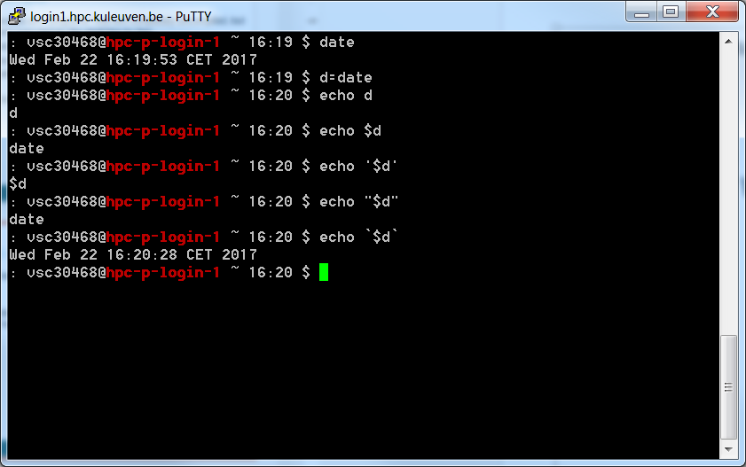
Example Of Quote Difference

Slide 8
Input and Output
Programs and commands can contain an input and output. These are called ‘streams’. UNIX programming is oftentimes stream based.
STDIN – ‘standard input,’ or input from the keyboard
SDTOUT – ‘standard output,’ or output to the screen
STDERR – ‘standard error,’ error output which is sent to the screen.

Slide 9
File Redirection
Often we want to save output (stdout) from a program to a file. This can be done with the ‘redirection’ operator.
myprogram > myfile – using the ‘>’ operator we redirect the output from myprogram to file myfile
Similarly, we can append the output to a file instead of rewriting it with a double ‘>>’
myprogram >> myfile – using the ‘>’ operator we append the output from myprogram to file myfile

Slide 10
Input Redirection
Input can also be given to a command from a file instead of typing it to the screen, which would be impractical.
mycommand < programinput – Here mycommand gets its input from programinput instead of waiting for what you type.

Slide 11
Redirecting stderr
Performing a normal redirection will not redirect sdterr. In Bash, this can be accomplished with ‘2>’
command 2> file1
Or, one can merge stderr to stdout (most popular) with ‘2>&1’
command > file 2>&1

Slide 12
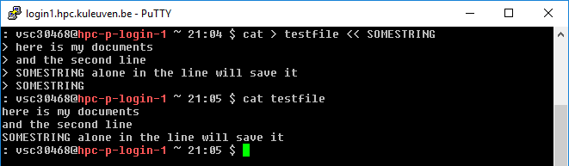
Redirecting: here docs and here strings
‘Here docs’ are files created inline in the shell.
The ‘trick’ is simple. Define a closing word, and the lines between that word and when it appears alone on a line become a file.
Notice that:
the string could be included in the file if it was not ‘alone’ on the line
the string SOMEENDSTRING is more normally END, but that is just convention
Lesser known is the ‘here string’:
$ cat > testfile <<< 'This file has one line'

Slide 13
Pipes
Using a pipe operator ‘|’ commands can be linked together. The pipe will link the standard output from one command to the standard input of another.
Very helpful for searching files
e.g. when we want to list the files, but only the ones that contain test in their name:
ls -la|grep test

Slide 14
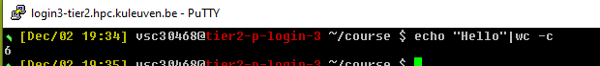
Pipes
Lots of Little Tools
echo “Hello” | \
wc -c
INPUT
0
echo
OUTPUT
ERROR
1
2
A Pipe!
INPUT
0
wc
OUTPUT
ERROR
1
2

Slide 15
Wc flags
-c, --bytes
print the byte counts
-m, --chars
print the character counts
-l, --lines
print the newline counts
-L, --max-line-length
print the length of the longest line
-w, --words
print the word counts
Example
wc file1

Slide 16
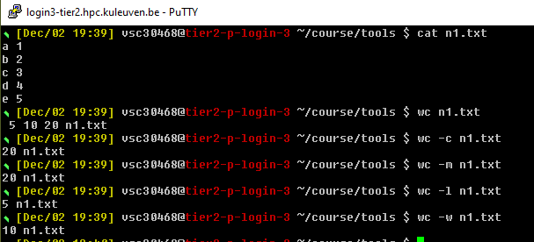
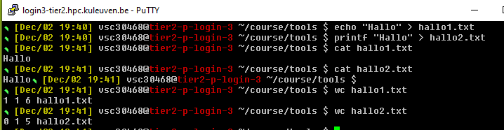
Wc example

Slide 17
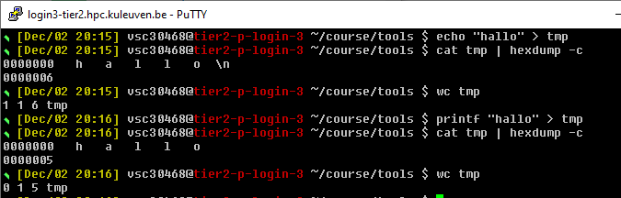
Wc example
hexdump - displays file contents in ascii, decimal, hexadecimal, or octal
-c: One-byte character display. Display the input offset in hexadecimal, followed by sixteen space-separated, three-column, space-filled characters of input data per line.
\n is the last character in the first line

Slide 18
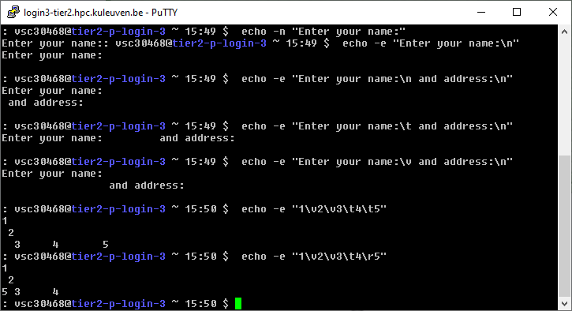
Printing/output
Basic use: echo (remember quotes!)
$ echo –n -> do not output the trailing newline
$ echo -e -> enable interpretation of backslash escapes
\n new line
\r carriage return
\t horizontal tab
\v vertical tab

Slide 19
Printing/output
Alternatively (when formatting needed): printf
printf [-v var] format [arguments]
Writes the formatted arguments to the standard output under the control of the format. The -v option causes the output to be assigned to the variable var rather than being printed to the standard output.
d - Format a value as a signed decimal number.
u - Format a value as an unsigned decimal number.
s - Format a value as a string.
Format specifiers can be preceded by a field width to specify the minimum number of characters to print. A positive width causes the value to be right-justified; a negative width causes the value to be left-justified. A width with a leading zero causes numeric fields to be zero-filled. Usually, you want to use negative widths for strings and positive widths for numbers.

Slide 20
Printing/output
Alternatively (when formatting needed): printf
printf [-v var] format [arguments]
Writes the formatted arguments to the standard output under the control of the format. The -v option causes the output to be assigned to the variable var rather than being printed to the standard output.

Slide 21
Printing/output
d - Format a value as a signed decimal number.
u - Format a value as an unsigned decimal number.
f – format as a floating number.
s - Format a value as a string.
Format specifiers can be preceded by a field width to specify the minimum number of characters to print. A positive width causes the value to be right-justified; a negative width causes the value to be left-justified. A width with a leading zero causes numeric fields to be zero-filled. Usually, you want to use negative widths for strings and positive widths for numbers.
Precision: The precision for a floating- or double-number can be specified by using .<DIGITS>, where <DIGITS> is the number of digits for precision
\n – new line

Slide 22
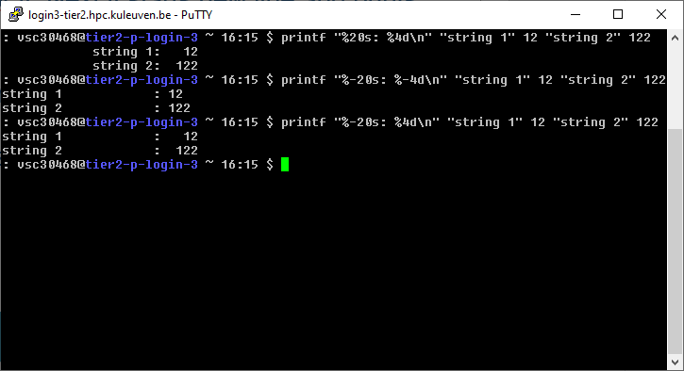
Printing/output
$ printf "%50s\n" "This field is 50 characters wide..." -> will be printed as a string of 50 characters ended with the new line
$ printf "%20s: %4d\n" "string 1" 12 "string 2" 122 -> prints string 1 in 20 character fiels and corresponding number 12 where 4 digits are reserved for it. Next it starts new line and prints string 2 and number 122.
Note that printf reuses the format if it runs out of format specifiers, which in the examples above allows you to print two lines (four values) with only two format specifiers.

Slide 23
Printing/output
The default behaviour of %f specifier is to print floating point numbers with 6 decimal places. To limit a decimal places to 2 we can specify a precision in a following manner:
$ printf "%.2f\n" 255 -> will print: 255.00
Formatting to three places with preceding with 0, separated with tab:
$ printf "%03d\t" 2 3 -> will print: 002 003

Slide 24
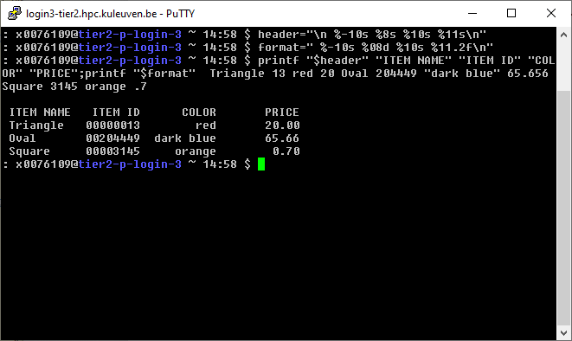
Printing/output
How to create a table with multiple items?
Definition of formats:
header="\n %-10s %8s %10s %11s\n"
format=" %-10s %08d %10s %11.2f\n"
Values to print:
printf "$header" "ITEM NAME" "ITEM ID" "COLOR" "PRICE";printf "$format" Triangle 13 red 20 Oval 204449 "dark blue" 65.656 Square 3145 orange .7

Slide 25
Columnate lists – column flags
-c, --columns width
Output is formatted to a width specified as number of characters.
-t, --table
Determine the number of columns the input contains and create a table. Columns are delimited with whitespace, by default, or with the characters supplied using the separator.
-s, --separator separators
Specify possible table delimiters (default is whitespace).
-o, --output-separator separators
Specify table output delimiter (default is two whitespaces).
-x, --fillrows
Fill columns before filling rows.
Example
column file1.txt

Slide 26
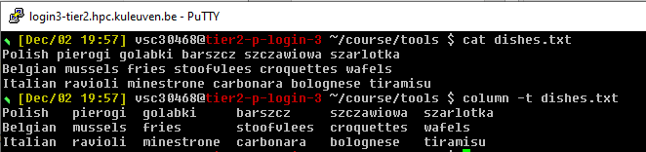
Column example

Slide 27
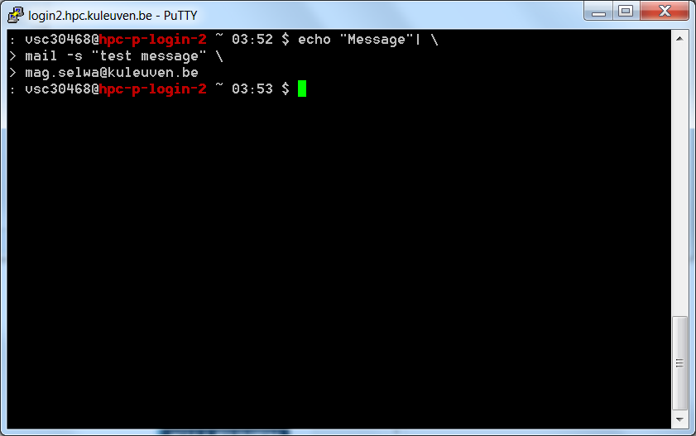
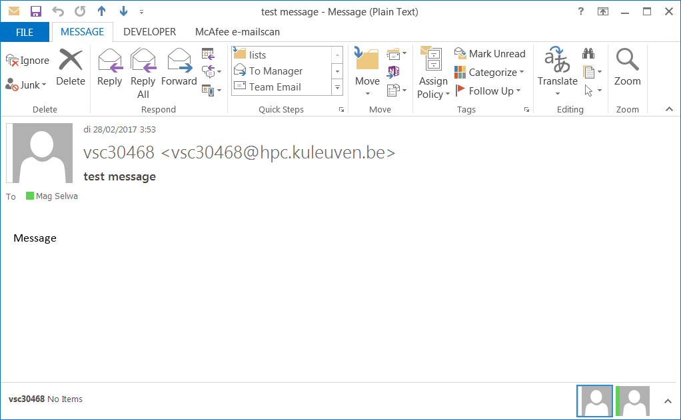
Email Notification
% echo “Message” | \
mail –s “Here’s your message” \
borwicjh@wfu.edu

Slide 28
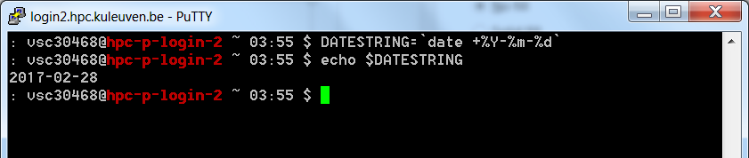
Dates
$ DATESTRING=`date +%Y%m%d`
$ echo $DATESTRING
20170227
$ man date

Slide 29
Defining local variables
As in any other programming language, variables can be defined and used in shell scripts.
Unlike other programming languages, variables in Shell Scripts are not typed.
Examples :
a=1234 # a is NOT an integer, a string instead
b=$a+1 # will not perform arithmetic but be the string ‘1234+1’
b=`expr $a + 1 ` will perform arithmetic so b is 1235 now.
Note : +,-,/,*,**, % operators are available.
b=abcde # b is string
b=‘abcde’ # same as above but much safer.
b=abc def # will not work unless ‘quoted’
b=‘abc def’ # i.e. this will work.
IMPORTANT: DO NOT LEAVE SPACES AROUND THE =

Slide 30
Some commands
cut – cuts columns of text from a file
echo – displays a line of text
paste – will paste columns of text into a file
join - operates on exactly two files, but pastes together only those lines with a common tagged field
sort – sorts a file of lines alfabetically
comm – compare 2 sorted files
tr – translates between characters (e.g. tr a-z A-Z)
sleep - Delay for a specified amount of time
uniq - Remove duplicate lines from a sorted file
bc – command line calculator (scale=2 to see 2 digits)

Slide 31
Paste flags
-d
Delimiter
-s
paste one file at a time instead of in parallel
Example
paste file1 file2

Slide 32
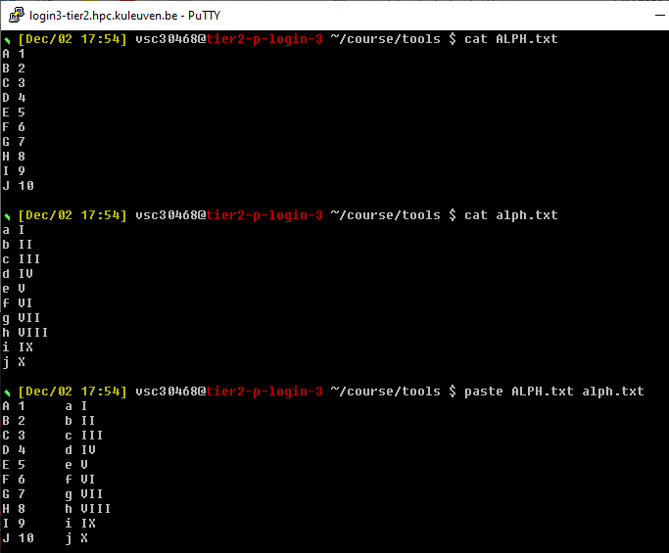
Paste example

Slide 33
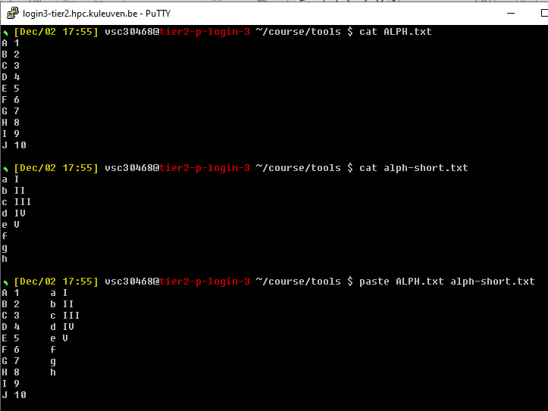
Paste example

Slide 34
Join flags
-i
Ignore case
-e EMPTY
replace missing input fields with EMPTY
-t CHAR
use CHAR as input and output field separator
-1 FIELD
join on this FIELD of file 1
-2 FIELD
join on this FIELD of file 2

Slide 35
Join flags
-a FILENUM
Also, print unpairable lines from file FILENUM, where FILENUM is 1 or 2, corresponding to FILE1 or FILE2.
-v
If you only want to print unpairable lines i.e suppress the paired lines in the output
-j
In case, we have the position of common field same in both the files(other than first) then we can simply replace the part -1[field] -2[field] in the command with -j[field]
Example
join file1 file2

Slide 36
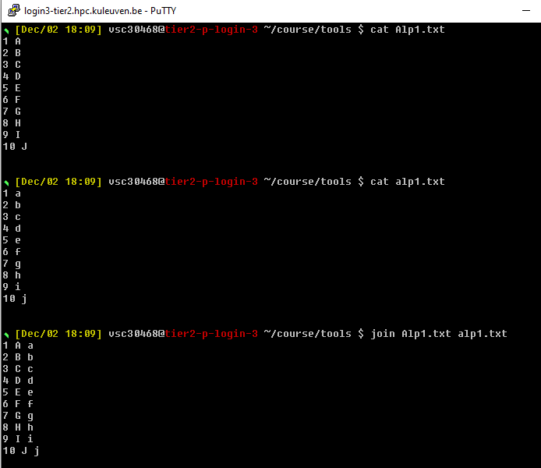
Join example

Slide 37
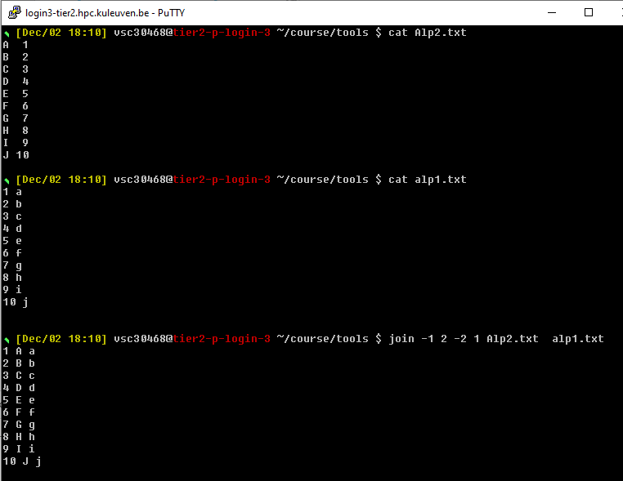
Join example

Slide 38
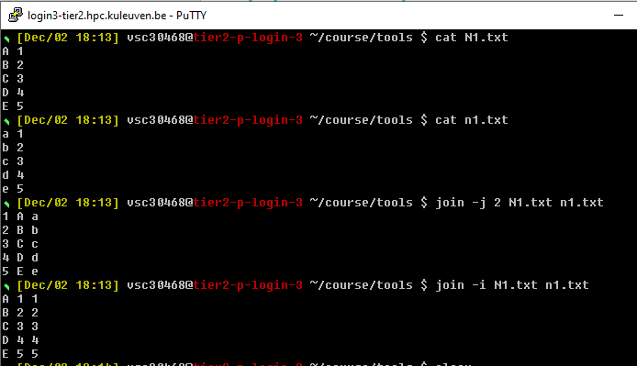
Join example

Slide 39
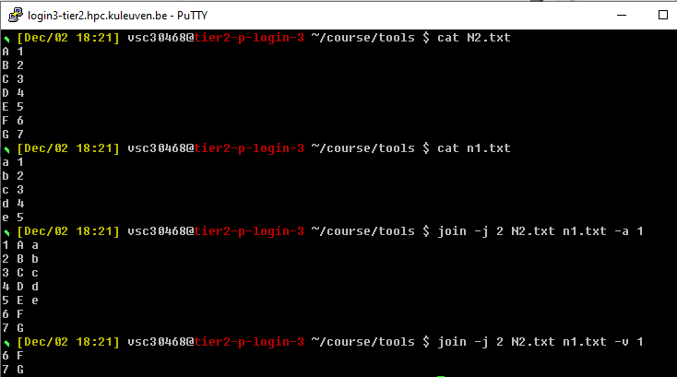
Join example

Slide 40
Sort flags
-r
reverse
-f
ignore case
-kn
sort according to column n
-n
compare according to string numerical value
-V
natural sort of (version) numbers within text (for files like file-1.txt, …, file-100.txt)
Example
sort –r -k3 < myFile

Slide 41
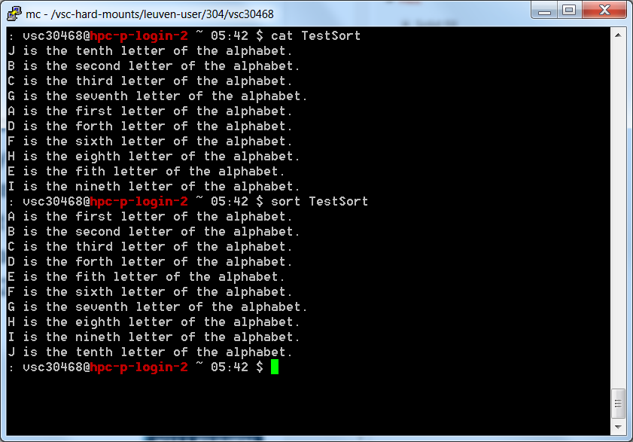
Sort example

Slide 42
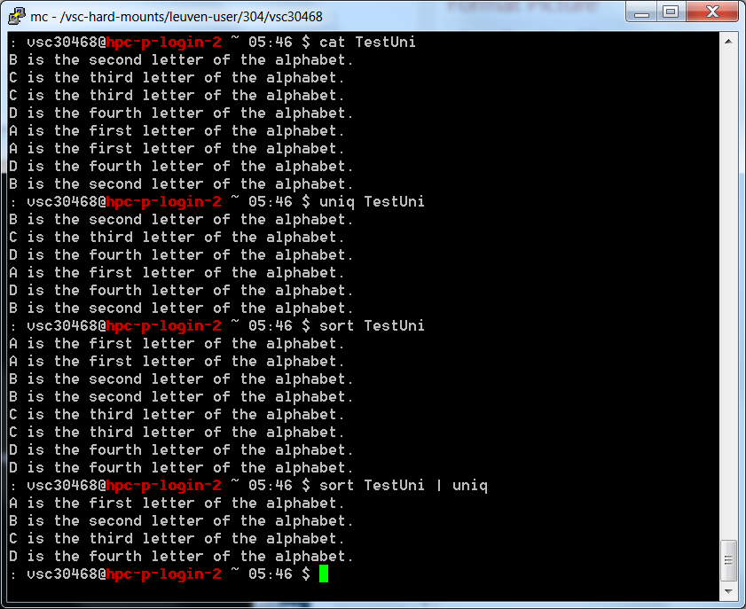
Uniq example
sort –u TestUni
will do the same

Slide 43
Cut flags
-d
Delimiter
-f
Field number
Example
cut –d‘ ‘ -f3 myFile

Slide 44
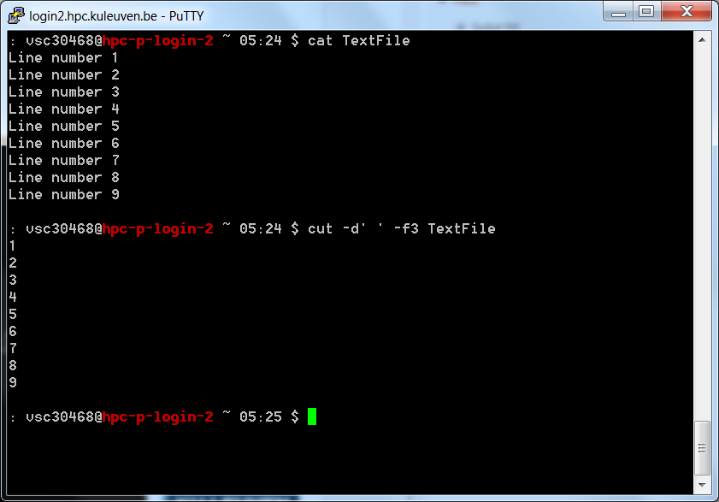
Example Of Cut

Slide 45
comm flags
Without any options, it prints output in three columns - lines unique to file1, line unique to file2 and lines common to both files
-1
suppress column 1 (lines unique to FILE1)
-2
suppress column 2 (lines unique to FILE2)
-3
suppress column 3 (lines that appear in both files)

Slide 46
comm flags
--check-order
check that the input is correctly sorted, even if all input lines are pairable
- --nocheck-order
do not check that the input is correctly sorted
--output-delimiter=STR
separate columns with STR
Example
comm file1 file2

Slide 47
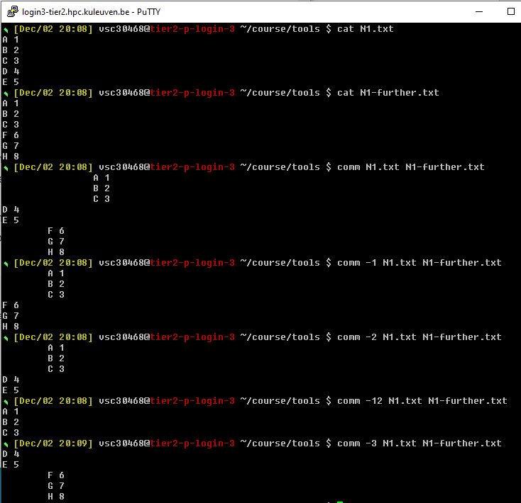
Comm example

Slide 48
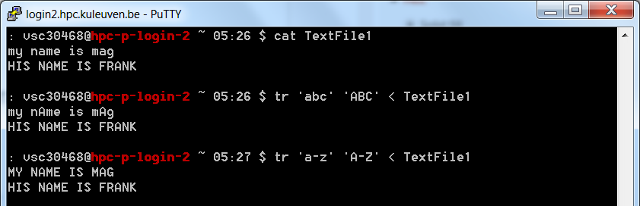
The ‘tr’ Command
Translate
Change on a one to one basis characters from one thing to another
Usage: tr ‘Set1’ ‘Set2’
Example: tr ‘abc’ ‘ABC’ < myFile
tr '[:lower:]' '[:upper:]' < myFile

Slide 49
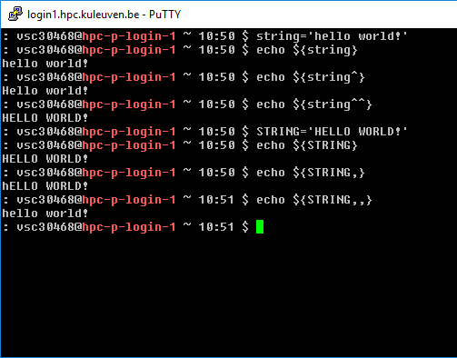
Lower/Upper case letters
Capitalize:
^^ - all the letters
^ - only the first letter
Lowercase:
,, - all the letters
, - only the first letter

Slide 50
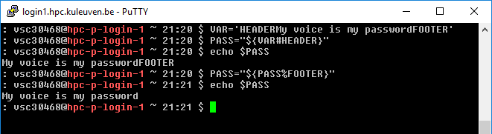
String manipulation
The # means ‘match and remove the following pattern from the start of the string’
The % means ‘match and remove the following pattern from the end of the string

Slide 51
Globbing: use wildcard
Wildcard | Function
* | Matches 0 or more characters
? | Matches 1 character
[abc] | Matches one of the characters listed
[a-c] | Matches one character in the range
[!abc] | Matches any character not listed
[!a-c] | Matches any character not listed in the range
{tacos,nachos} | Matches one word in the list

Slide 52
grep – Global / Regular Expressions / Pattern
Searches the internals of files and tries to match patterns
Used to see if a file contains data you are looking for
Will print out every line that contains a match for that pattern
Usage: grep [OPTIONS] pattern [FILE]

Slide 53
Useful tools
grep
Pattern searching
Example: grep parameters pattern filename
-v (invert the sense of matching, to select non-matching lines)
-i (ignore case)
-e/-E (Look for expression/extended expression)
$ grep ";E;" $PBSLOGSDIR/$file | grep -E "gpu1\/|gpu2\/|gpu3" > $file

Slide 54
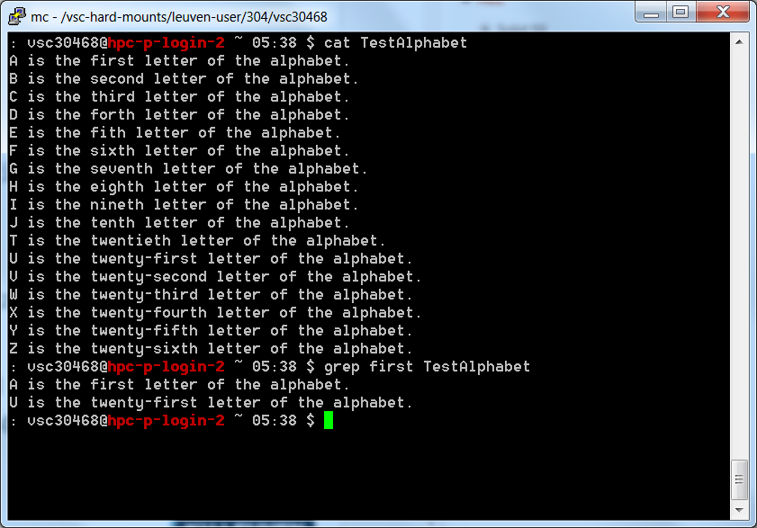
Useful tools

Slide 55
Common Flags
-i
Case insensitive (upper and lower cases are treated the same)
-n
Print out the line numbers
-r
Recursively traverse the directory
-v
Invert the results (show all non-matching lines)
-l
Shows only the name of matching file, not the matches (useful in combination with find)
alias grep='grep --color=auto'
Possible alias in .bashrc to highlight matches in the output, making it easy to spot them.

Slide 56
Easiest grep Usage
The easiest way to use grep is also the most common way to use grep
Search files for occurrences of a string (word)
The pattern you search for can simply be a word

Slide 57
Regular Expressions
grep can be used to find words that match a certain pattern, not just a given word
The language of regular expressions is used to describe these patterns
This includes wildcards, repetitions, and complex patterns

Slide 58
How grep Views Regular Expressions
Unfortunately, grep’s regular expressions are completely different than the shell wildcards
Some of the symbols are the same, but they are used in different ways
Always use quotes (‘) so that the wildcards are interpreted by grep and not the shell

Slide 59
Notation
^
Beginning of the line – left rooted
$
End of the line – right rooted
.
Any single character
[xy]
Any character in the set
[^a-z]
Any character not in the set
B*
Zero or more occurrences of B

Slide 60
Examples
.*
Zero or more of any character
Will match any pattern
^ab*
Any line that starts with a and has zero or more b’s immediately following
ab
abbbb
abb

Slide 61
Examples
[0-9]
Any number
1002
0909
bye$
The pattern “bye” located at the end of the line
Hello and goodbye

Slide 62
One More Slide Of Examples…
[^g]$
Match any line that does not end in g
[:alpha:]*
Any word that contains zero or more alphabetic characters

Slide 63
Inverting The Answers
grep –v ‘this’ testFile
Will find all lines that do not contain the word this
Works exactly the same with regular expressions
grep –v ‘[^g$]’ testFile
Finds all lines that end in g

Slide 64
Your own command?
The xargs command in UNIX is a command line utility for building an execution pipeline from standard input. Whilst tools like grep can accept standard input as a parameter, many other tools cannot. Using xargs allows tools like echo and rm and mkdir to accept standard input as arguments.
By default xargs reads items from standard input as separated by blanks and executes a command once for each argument.

Slide 65
Your own command?
In the following example standard input is piped to xargs and the mkdir command is run for each argument, creating three folders.

Slide 66
xargs+find
The most common usage of xargs is to use it with the find command. This uses find to search for files or directories and then uses xargs to operate on the results. Typical examples of this are changing the ownership of files or moving files.
find and xargs can be used together to operate on files that match certain attributes.

Slide 67
xargs+find
In the following example files older than two weeks in the temp folder are found and then piped to the xargs command which runs the rm command on each file and removes them.
$ find /tmp -mtime +14 | xargs rm

Slide 68
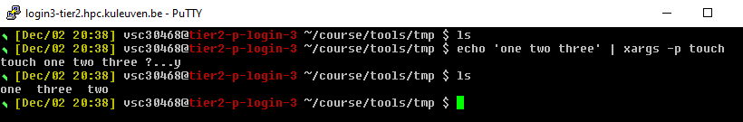
xargs
xargs can print commands that are executed
The -t option prints each command that will be executed to the terminal. This can be helpful when debugging scripts.
xargs allows to view the command and prompt for execution
The -p command will print the command to be executed and prompt the user to run it. This can be useful for destructive operations where you really want to be sure on the command to be run.

Slide 69
Hands-on 1

Slide 70

Vmware in pc-klas

Slide 71

Vmware in pc-klas

Slide 72
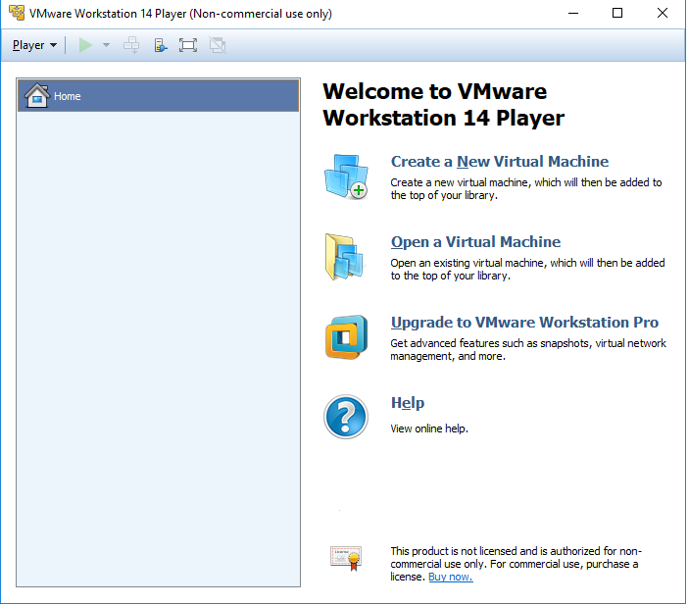
Vmware in pc-klas

Slide 73
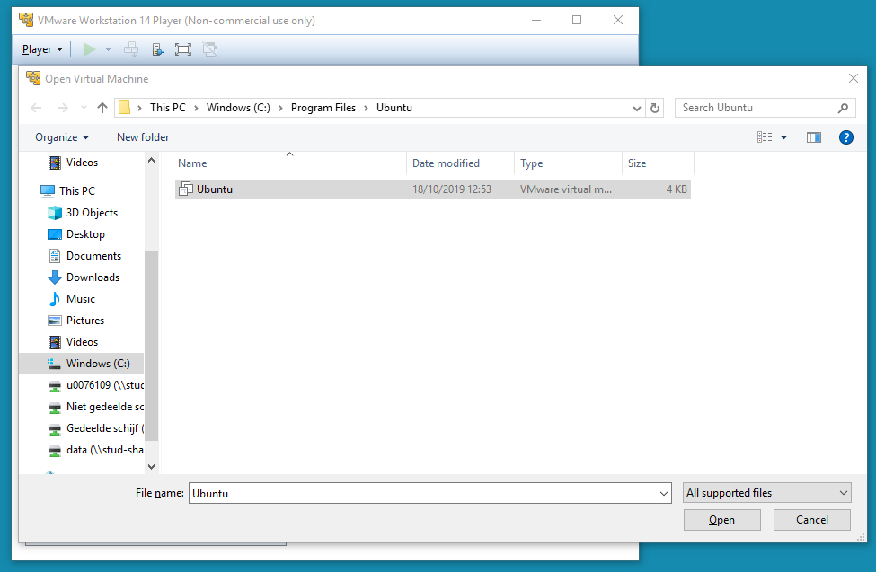
Vmware in pc-klas

Slide 74
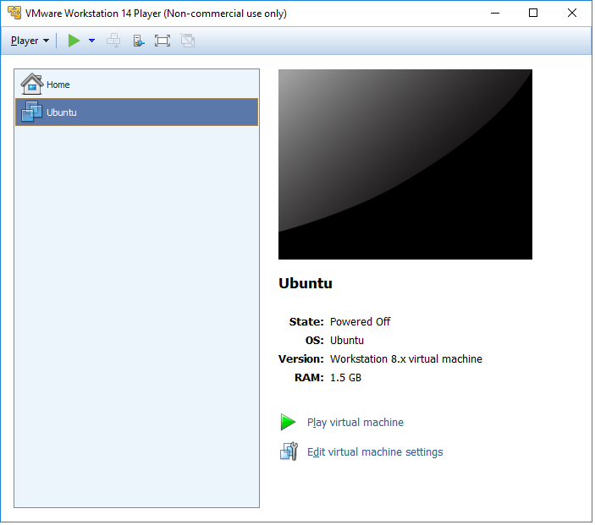
Vmware in pc-klas

Slide 75
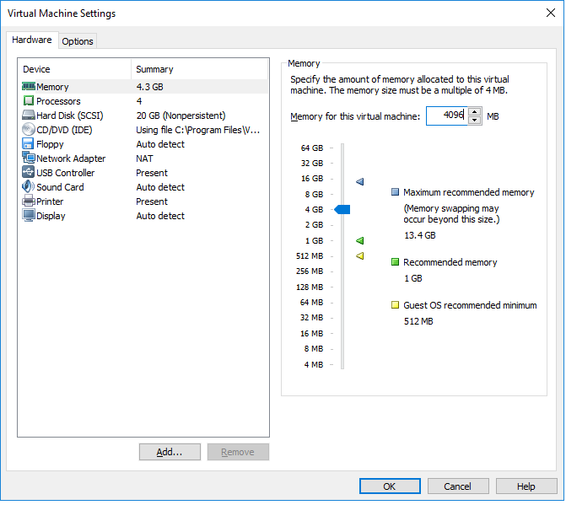
Vmware in pc-klas

Slide 76
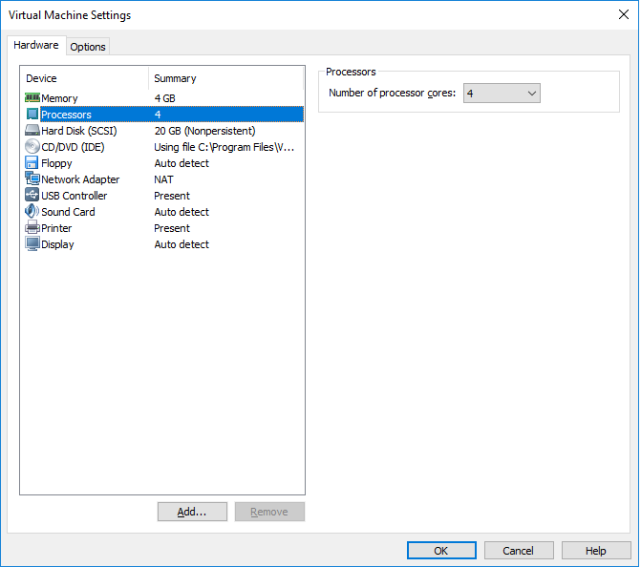
Vmware in pc-klas

Slide 77
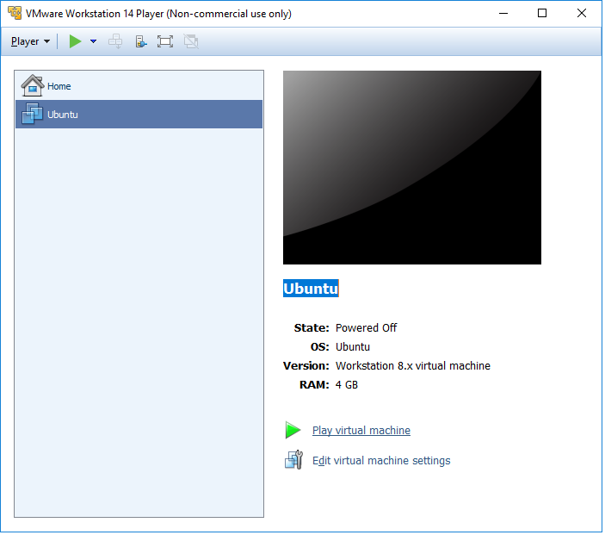
Vmware in pc-klas

Slide 78

Vmware in pc-klas

Slide 79
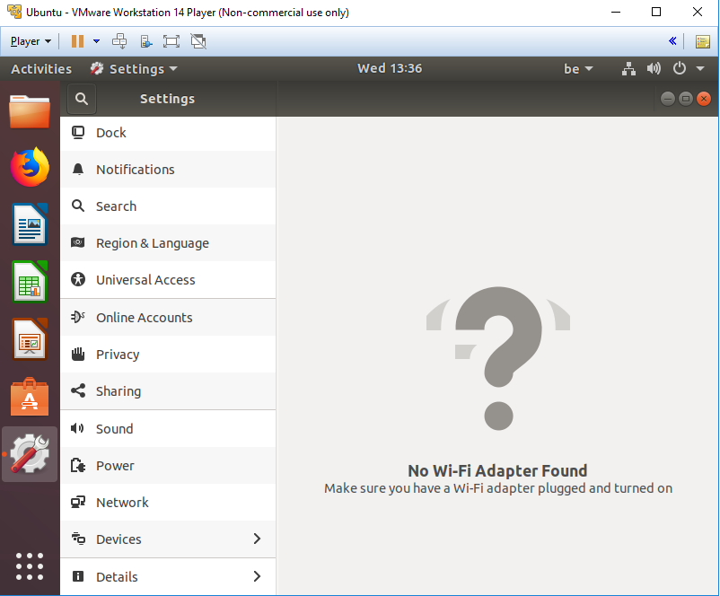
Vmware in pc-klas

Slide 80
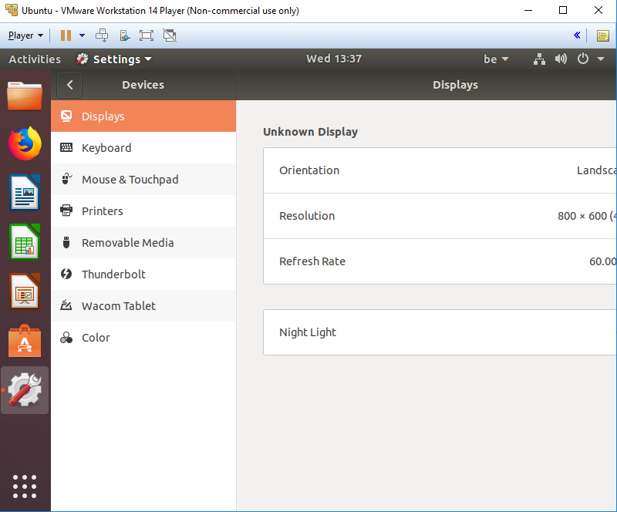
Vmware in pc-klas

Slide 81
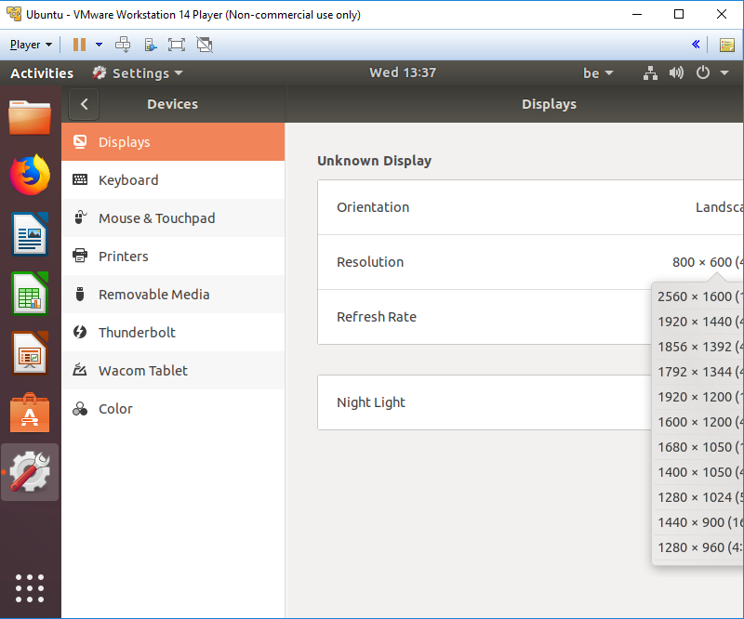
Vmware in pc-klas

Slide 82
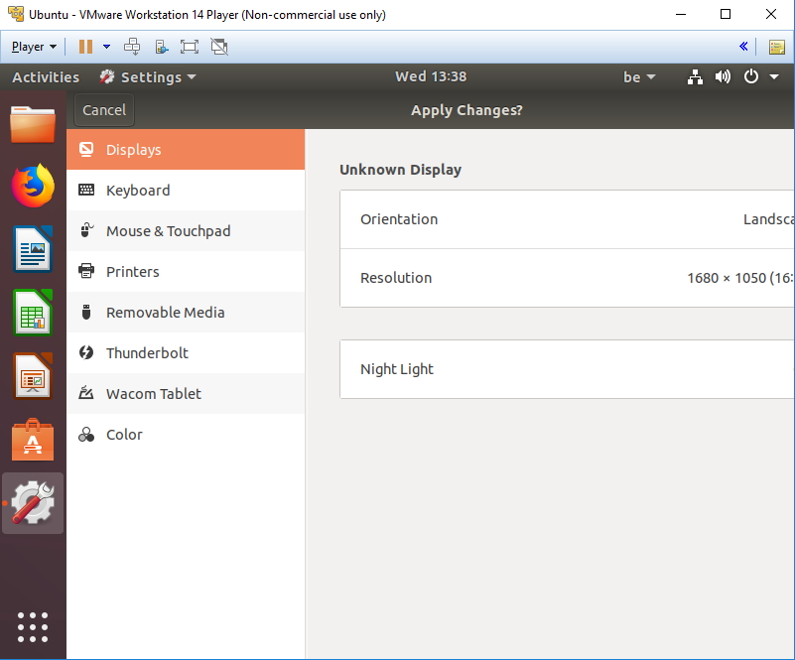
Vmware in pc-klas

Slide 83
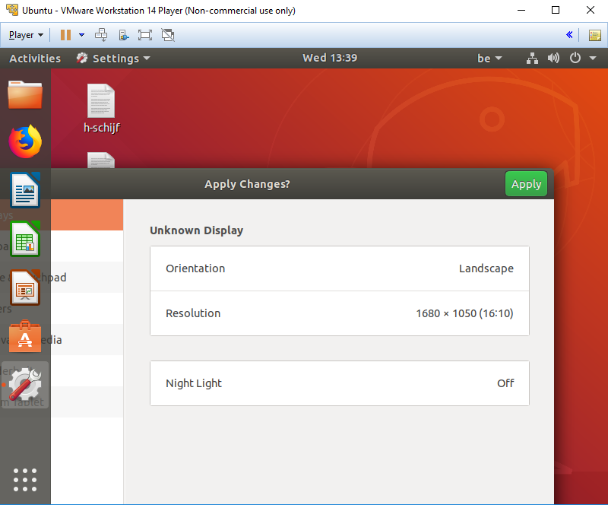
Vmware in pc-klas

Slide 84
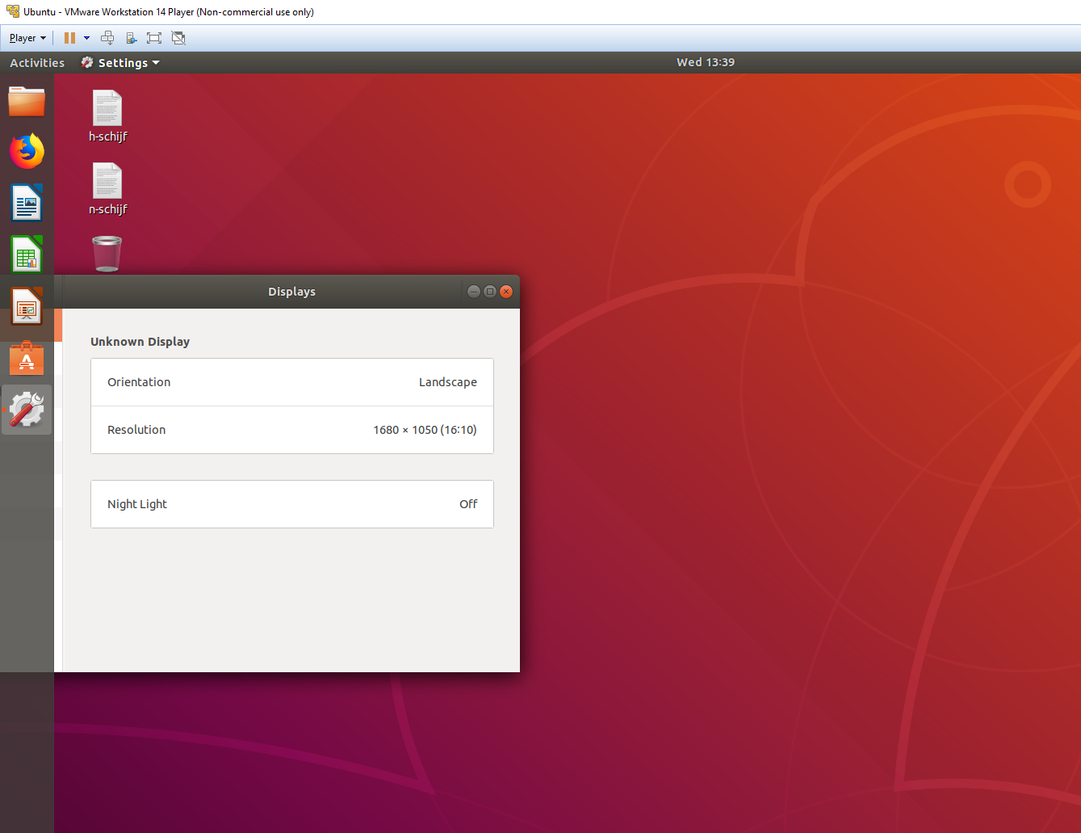
Vmware in pc-klas

Slide 85

Vmware in pc-klas

Slide 86
Create a file that has a filename of the date in the format DD-MM-YY.log
Download the file https://sites.google.com/site/magselwakuleuven/downloads/ex1.fa and change all the capital letter A and C into lower case (save into a new file)
Modify ex1.fa file so that A is changed into B, C into D, etc. (save into a new file)
Create a file containing some information, e.g. “Hello Mag, it is a nice sunny day.” Write a conversion tool for Rot13 (https://en.wikipedia.org/wiki/ROT13). Apply it once to the file, check the output, apply again and compare the output with the original file.
Download the file https://sites.google.com/site/magselwakuleuven/downloads/lp_hpcinfo and save into a new file only column 5
Remove duplicated lines from the file
Sort lp_hpcinfo according to the 5th column
Download the file https://sites.google.com/site/magselwakuleuven/downloads/20170601 and print only lines that contain Exit_status=0
From 20170601 print only lines that do not contain “;E;”
From 20170601 print only lines that contain r3i0n11 or r3i0n12
From 20170601 print only lines that contain both “;E; and “Exit_status=0”

Slide 87
touch `date +%d-%m-%y`.log
tr [A-C] [a-c] < ex1.fa > ex1a.fa
tr '[A-Z]' '[B-ZA]' <ex1.fa
tr A-Za-z N-ZA-Mn-za-m < r13inp.txt > r13out1.txt
tr A-Za-z N-ZA-Mn-za-m < r13out1.txt > r13out2.txt
diff rot13-input.txt rot13-output2.txt
cut -d' ' -f5 lp_hpcinfo > hpcinfo.log
sort hpcinfo.log |uniq > hpcinfo
or: sort –u hpcinfo.log > hpcinfo
sort lp_hpcinfo -k 5
grep "Exit_status=0" 20170601
grep -v ";E;" 20170601
grep -E "r3i0n11|r3i0n12" 20170601
or grep -E "r3i0n1[1-2]" 20170601
grep "Exit_status=0" 20170601 |grep ";E;"

Slide 88
touch `date +%d-%m-%y`.log
tr [A-C] [a-c] < ex1.fa > ex1a.fa
tr '[A-Z]' '[B-ZA]' <ex1.fa
tr A-Za-z N-ZA-Mn-za-m < r13inp.txt > r13out1.txt
tr A-Za-z N-ZA-Mn-za-m < r13out1.txt > r13out2.txt
diff rot13-input.txt rot13-output2.txt
cut -d' ' -f5 lp_hpcinfo > hpcinfo.log
sort hpcinfo.log |uniq > hpcinfo
or: sort –u hpcinfo.log > hpcinfo
sort lp_hpcinfo -k 5
grep "Exit_status=0" 20170601
grep -v ";E;" 20170601
grep -E "r3i0n11|r3i0n12" 20170601
or grep -E "r3i0n1[1-2]" 20170601
or grep -E "r3i0n1[12]"
grep "Exit_status=0" 20170601 |grep ";E;"

Slide 89
Useful tools
Sed (Stream Editor)
Text editing
Example: sed 's/XYZ/xyz/g' filename
Awk (Alfred Aho, Peter Weinberger, and Brian Kernighan)
Pattern scanning and processing
Example: awk ‘{print $4, $7}’ filename

Slide 90
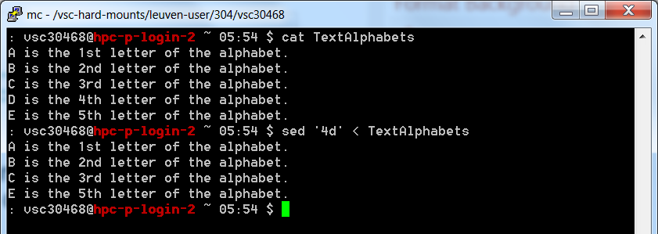
The ‘sed’ Command/Language
Filter
Like grep, sort, or uniq, it takes input and performs some operation on it to filter the output
Usage: sed ‘Address Command’
Address specifies where to make changes
Command specifies what change to make
Example:
sed ‘4d’ textFile
Delete 4th line

Slide 91
How Does sed Work?
sed reads line of input
line of input is copied into a temporary buffer called pattern space
editing commands are applied
subsequent commands are applied to line in the pattern space, not the original input line
once finished, line is sent to output (unless –n option was used)
line is removed from pattern space
sed reads next line of input, until end of file
Note: input file is unchanged

Slide 92
Pattern and Hold spaces
Pattern space: Workspace or temporary buffer where a single line of input is held while the editing commands are applied
Hold space: Secondary temporary buffer for temporary storage only
Input
scriptfile
Input line
(Pattern Space)
Hold Space
Output

Slide 93
Address Specification
Addresses could be line numbers or regular expressions
No address – each line
One address – only that line
Two comma separated addresses – All lines in between
! – All other lines
But: delete 2 separate lines: sed '1d;4d'

Slide 94
Some commands Available To sed
a\
Append text
c\
Replace text
i\
Insert text before
d
Delete lines
s
Make substitutions

Slide 95
More sed commands
p - print
r - read
w - write
y - transform
= - display line number
N - append the next line to the current one
q - quit

Slide 96
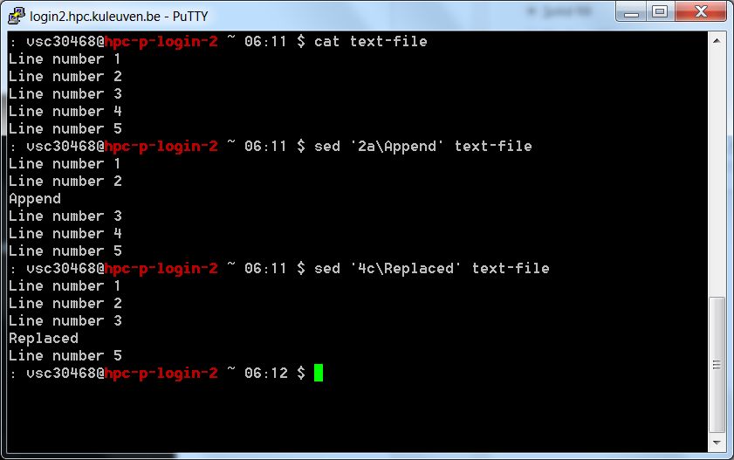
Examples
Append after 2nd line
Replace 4th line

Slide 97
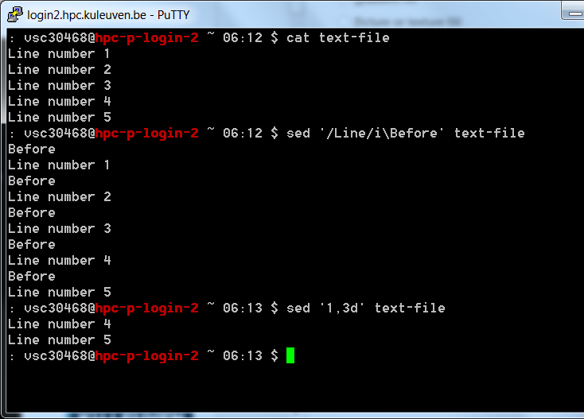
More Examples
Insert before “Line”
Delete lines 1-3

Slide 98
When Would You Want To Use sed?
sed works on streams, so it is perfect to be placed in the middle of a pipe in order to change the output from one format to another
Example:
If a program always prints out 4 lines of junk for every good line, sed can be used to weed out the junk

Slide 99
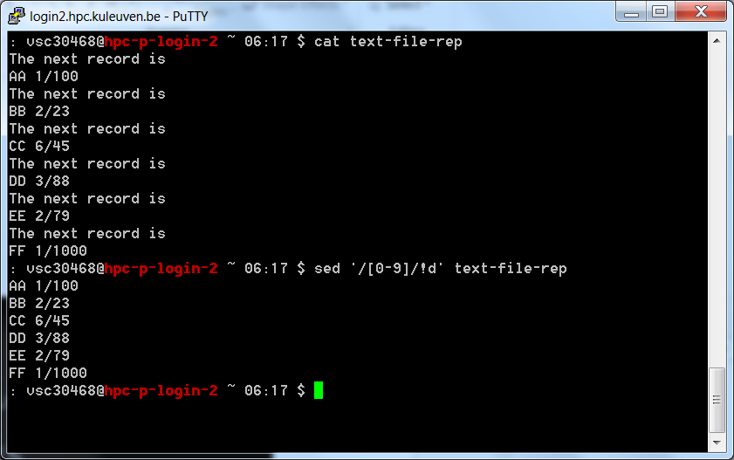
Example
Delete lines without numbers

Slide 100
Sed Usage
Edit files too large for interactive editing
Edit any size files where editing sequence is too complicated to type in interactive mode
Perform “multiple global” editing functions efficiently in one pass through the input
Edit multiples files automatically
Good tool for writing conversion programs

Slide 101
Conceptual overview
A script is read which contains a list of editing commands
Can be specified in a file or as an argument
Before any editing is done, all editing commands are compiled into a form to be more efficient during the execution phase.
All editing commands in a sed script are applied in order to each input line.
If a command changes the input, subsequent command address will be applied to the current (modified) line in the pattern space, not the original input line.
The original input file is unchanged (sed is a filter), and the results are sent to standard output (but can be redirected to a file).

Slide 102
sed Syntax
sed [-n] [-e] [‘command’] [file…]
sed [-n] [-f scriptfile] [file…]
-n - only print lines specified with the print command (or the ‘p’ flag of the substitute (‘s’) command)
-f scriptfile - next argument is a filename containing editing commands
-e command - the next argument is an editing command rather than a filename, useful if multiple commands are specified

Slide 103
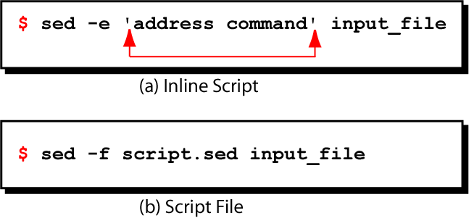
sed syntax

Slide 104
Commands
command is a single letter
Example:
Deletion: d
[address1][,address2]d
Delete the addressed line(s) from the pattern space; line(s) not passed to standard output.
A new line of input is read and editing resumes with the first command of the script.

Slide 105
Address and Command Examples: delete
d deletes all lines
6d deletes line 6
/^$/d deletes all blank lines
1,10d deletes lines 1 through 10
1,/^$/d deletes from line 1 through the first blank line
/^$/,$d deletes from the first blank line through the last line of the file
/^$/,10d deletes from the first blank line through line 10
/^ya*y/,/[0-9]$/d deletes from the first line that begins with yay, yaay, yaaay, etc. through the first line that ends with a digit

Slide 106
Multiple Commands
Braces {} can be used to apply multiple commands to an address
[address][,address]{
command1
command2
command3
}
The opening brace must be the last character on a line
The closing brace must be on a line by itself
Make sure there are no spaces following the braces
Alternatively, use “;” after each command:
[address][,address]{command1; command2; command3; }

Slide 107
Print
The print command (p) can be used to force the pattern space to be output, useful if the -n option has been specified
Syntax:
[address1[,address2]]p
Note: if the -n or #n option has not been specified, p will cause the line to be output twice!
Examples:
1,5p will display lines 1 through 5
/^$/,$p will display the lines from the first
blank line through the last line of the file

Slide 108
Substitute
Syntax:
[address(es)]s/pattern/replacement/[flags]
pattern - search pattern
replacement - replacement string for pattern
flags - optionally any of the following
n a number from 1 to 512 indicating which occurrence of pattern should be replaced
g global, replace all occurrences of pattern in pattern space
p print contents of pattern space

Slide 109
Substitute Examples
s/Puff Daddy/P. Diddy/
Substitute P. Diddy for the first occurrence
of Puff Daddy in pattern space
s/Tom/Fred/2
Substitutes Fred for the second occurrence
of Tom in the pattern space
s/wood/plastic/p
Substitutes plastic for the first occurrence
of wood and outputs (prints) pattern space

Slide 110
Append, Insert, and Change
Syntax for these commands is a little strange because they must be specified on multiple lines
append
[address]a\
text
insert
[address]i\
text
change
[address(es)]c\
text
append/insert for single lines only, not range

Slide 111
Append and Insert
Append places text after the current line in pattern space
Insert places text before the current line in pattern space
each of these commands requires a \ following it
text must begin on the next line.
if text begins with whitespace, sed will discard it unless you start the line with a \

Slide 112
Using !
If an address is followed by an exclamation point (!), the associated command is applied to all lines that don’t match the address or address range
Examples:
1,5!d delete all lines except 1 through 5
/black/!s/cow/horse/
substitute “horse” for “cow” on all lines
except those that contained “black”
e.g.
“The brown cow” -> “The brown horse”
“The black cow” -> “The black cow”

Slide 113
Regular Expressions: use with sed
Metacharacter | Description/Matches…
. | Any one character, except new line
* | Zero or more of preceding character
^ | A character at beginning of line
$ | A character at end of line
\char | Escape the meaning of char following it
[ ] | Any one of the enclosed characters
\( \) | Tags matched characters to be used later
x\{m\} | Repetition of character x, m times
\< | Beginning of word
\> | End of word

Slide 114
Sed – more info
https://www.gnu.org/software/sed/manual/sed.html
https://www.tutorialspoint.com/sed/
http://www.grymoire.com/Unix/Sed.html
….
Useful examples (for all the tools):
https://www.howtogeek.com
https://stackoverflow.com

Slide 115
Hands-on 2

Slide 116
Create the file test10.log containing
A is the first letter
B is the second letter
C is the third letter
D is the fourth letter
E is the fifth letter
F is the sixth letter
G is the seventh letter
H is the eighth letter
i is the ninth letter
j is the tenth letter
Make a new file named 1.sed which has only lines 1,2,3,4,5 and 6 from the original input file
Make a new file which has only lines 2 and 4 removed from the original file
Make a new file which has the line “The end” added to the end of the file
Make a new file which has the line “The end” added after the line containing “tenth”
Make a new file which has 8th line changed into “Change”
Make a new file which has the 1st line changed into “A is the 1st letter”
Make a new file which has only lines containing at least one upper case character

Slide 117
nano test10.log
sed '1,6!d' test10.log > 1.sed
or
sed -n 1,6p test10.log > 1.sed
sed -e '2d;4d' test10.log > 2.sed
sed '$ a\ The end' test10.log > 3.sed
sed '/tenth/a\ The end' test10.log > 4.sed
sed 's/H is the eighth letter/Change/' test10.log > 5.sed
or
sed -e '/eighth/i\Change' test10.log|sed 9d > 5.sed
or
sed 8c\Change test10.log > 5.sed
sed '/first/c\A is the 1st letter' test10.log > 6.sed
or
sed s/first/1st/ test10.log > 6.sed
8. sed '/[A-Z]/!d' test10.log > 7.sed

Slide 118
awk
Answers the question:
What do I do if I want to search for a pattern and actually use it?
Combination of grep and other commands
Searches for some pattern or condition and performs some command on it
Complete programming language
Looks a lot like C syntactically
Variables are declared bash style

Slide 119
When Would You Want To Use awk?
Whenever you want to search for some pattern and perform some action
Example: I want to go through and calculate the average score on the Midterm

Slide 120
Advantages of Awk
awk is an interpreted language so you can avoid the usually lengthy edit-compile-test-debug cycle of software development.
Can be used for rapid prototyping.
The awk language is very useful for producing reports from large amounts of raw data, such as summarizing information from the output of other utility programs like ls.

Slide 121
Combining Expression Options
||
Or
&&
And
\( \)
Grouping

Slide 122
Action Commands
-print
Simply prints out the name of the file that was found
Most common action
-exec
Executes a command
-ok
Executes a command, but prompts the user first

Slide 123
Sed vs. awk
sed is a pattern-action language, like awk
awk processes fields while sed only processes lines
sed +
regular expressions
fast
concise
sed –
hard to remember text from one line to another
not possible to go backward in the file
no way to do forward references like /..../+1
no facilities to manipulate numbers
cumbersome syntax
awk +
convenient numeric processing
variables and control flow in the actions
convenient way of accessing fields within lines
flexible printing
C-like syntax

Slide 124
A few basic things about awk
awk reads from a file or from its standard input, and outputs to its standard output.
awk recognizes the concepts of "file", "record" and "field".
A file consists of records, which by default are the lines of the file. One line becomes one record.
awk operates on one record at a time.
A record consists of fields, which by default are separated by any number of spaces or tabs.
Field number 1 is accessed with $1, field 2 with $2, and so forth. $0 refers to the whole record.

Slide 125
Program Structure in Awk
An awk program is a sequence of statements of the form:
pattern { action }
pattern { action }
...
pattern in front of an action acts as a selector that determines whether the action is to be executed.
Patterns can be : regular expressions, arithmetic relational expressions, string-valued expressions, and arbitrary boolean combinations of these.
action is a sequence of action statements terminated by newlines or semicolons.

Slide 126
A simple example
$ awk –F”:” ‘/ftp/ {print $1 “ “ $3}’ /etc/passwd
Awk
executable
Field
Separator
Action to
perform on line
If pattern matches
pattern
to search
The file
to operate
upon

Slide 127
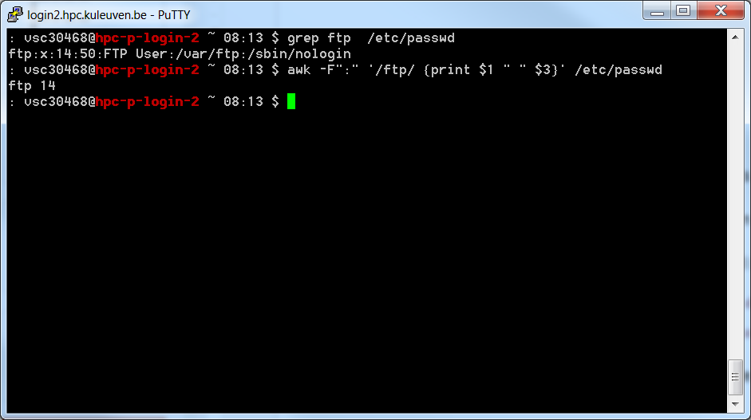
A simple example (cont..)
$ awk –F”:” ‘/arun/ {print $1 “ “ $3}’ /etc/passwd
Awk
executable
Field
Separator
Action to
perform on line
If pattern matches
pattern
to search
The file
to operate
upon

Slide 128
Running awk programs
There are four ways in which we can run awk programs
One-shot: Running a short throw-away awk program.
$ awk 'program' input-file1 input-file2
... where program consists of a series of patterns and actions.
Read Terminal: Using no input files (input from terminal instead).
$ awk 'program' <ENTER>
<input lines>
<input lines>
ctrl-d
Long: Putting permanent awk programs in files.
$ awk -f source-file input-file1 input-file2 ...
Executable: self-contained awk scripts, using the `#!' script mechanism.
Self-contained awk scripts are useful when you want to write a program which users can invoke without their having to know that the program is written in awk.

Slide 129
Basic awk Syntax
awk [options] ‘script’ file(s)
awk [options] –f scriptfile file(s)
Options:
-F to change input field separator
-f to name script file

Slide 130
Basic awk Program
consists of patterns & actions:
pattern {action}
if pattern is missing, action is applied to all lines
if action is missing, the matched line is printed
must have either pattern or action
Example:
awk '/for/' testfile
prints all lines containing string “for” in testfile

Slide 131
Basic Terminology: input file
A field is a unit of data in a line
Each field is separated from the other fields by the field separator
default field separator is whitespace
A record is the collection of fields in a line
A data file is made up of records

Slide 132
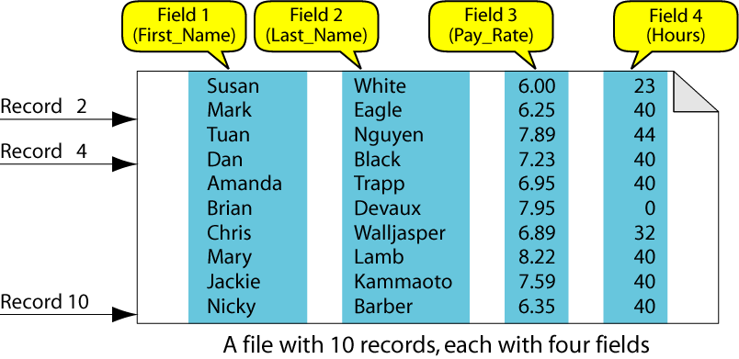
Example Input File

Slide 133
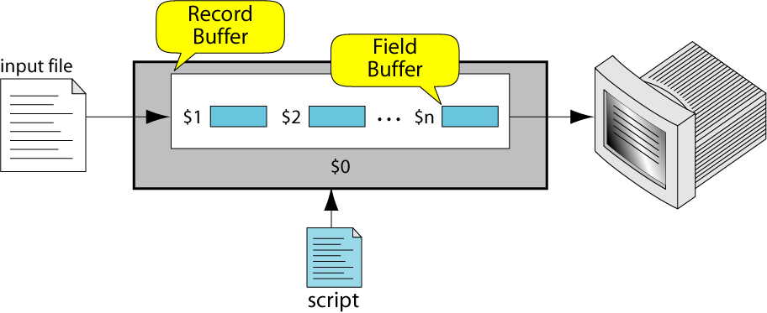
Buffers
awk supports two types of buffers:
record and field
field buffer:
one for each fields in the current record.
names: $1, $2, …
record buffer :
$0 holds the entire record

Slide 134
Some System Variables
FS Field separator (default=whitespace)
RS Record separator (default=\n)
NF Number of fields in current record
NR Number of the current record
OFS Output field separator (default=space)
ORS Output record separator (default=\n)
FILENAME Current filename

Slide 135
Example: Records and Fields
$ cat emps
Tom Jones 4424 5/12/66 543354
Mary Adams 5346 11/4/63 28765
Sally Chang 1654 7/22/54 650000
Billy Black 1683 9/23/44 336500
$ awk '{print NR, $0}' emps
1 Tom Jones 4424 5/12/66 543354
2 Mary Adams 5346 11/4/63 28765
3 Sally Chang 1654 7/22/54 650000
4 Billy Black 1683 9/23/44 336500

Slide 136
Example: Space as Field Separator
$ cat emps
Tom Jones 4424 5/12/66 543354
Mary Adams 5346 11/4/63 28765
Sally Chang 1654 7/22/54 650000
Billy Black 1683 9/23/44 336500
$ awk '{print NR, $1, $2, $5}' emps
1 Tom Jones 543354
2 Mary Adams 28765
3 Sally Chang 650000
4 Billy Black 336500

Slide 137
Example: Colon as Field Separator
$ cat em2
Tom Jones:4424:5/12/66:543354
Mary Adams:5346:11/4/63:28765
Sally Chang:1654:7/22/54:650000
Billy Black:1683:9/23/44:336500
$ awk -F: '/Jones/{print $1, $2}' em2
Tom Jones 4424

Slide 138
Advanced awk features
Awk borrows a lot from the C language.
The if loop, for loop and while loop have the same constructs as in C.
Awk’s variables are stored internally as strings.
eg. x = “1.01”
x = x + 1
print x
The above will print the value 2.01
Comparison operators in awk are : "==", "<", ">", "<=", ">=", "!=“, "~" and "!~“.
“~” and “!~” operators mean "matches" and "does not match".

Slide 139
Awk Examples
$ awk '{ print $0 }' /etc/passwd
Prints all the lines in /etc/passwd
$ awk -F":" '{ print "username: " $1 "\t\tuid:" $3" }' /etc/passwd
Prints the 1st and 3rd fields of each line in /etc/passwd. The fields are separated by “:”
$ awk –f script1.awk /etc/passwd
script1.awk
BEGIN{ x=0 }# The BEGIN block is executed before processing the file
/^$/ { x=x+1 } # For every null line increment the count
END { print "I found " x " blank lines. :)" } #Executed at the end
The above script calculates the number of null lines. Note that BEGIN and END are
special patterns.

Slide 140
Awk examples (cont..)
$ awk 'BEGIN { RS = "/" } ; { print $0 }' file1.txt
RS is the record separator (default is \n). In this example the RS is modified to “/”
and then the file is processed. So awk will distinguish between records by “/”
character.
$ awk '$1 ~ /foo/ { print $0 }' file.txt
The pattern will print out all records from file file.txt whose first fields contain the
string “foo”.
$ awk '{ print $(2*2) }' file.txt
In the above example the field number is an expression. So awk will print the 4th fields
of all the records.

Slide 141
Awk examples (cont..)
$ awk '{ $3 = $2 - 10; print $2, $3 }' inventory-shipped
This example will subtract the second field of each record by 10 and store
it in the third field.
$ awk 'BEGIN { FS = "," } ; { print $2 }' file.txt
FS is the field separator in awk. In the above example we are asking awk to
separate the fields by “,” instead of default “ “.
$ awk 'BEGIN { OFS = ";"; ORS = "\n\n" }
{ print $1, $2 }' file1.txt
OFS is the Output field Separator, ORS is Output record separator. This
prints the first and second fields of each input record separated by a
semicolon, with a blank line added after each line.

Slide 142
Awk examples
Consider that we have the following input in a file called grades
john 85 92 78 94 88
andrea 89 90 75 90 86
jasper 84 88 80 92 84
The following awk script will find the average
# average five grades
{ total = $2 + $3 + $4 + $5 + $6
avg = total / 5
print $1, avg }
$ awk –f grades.awk grades

Slide 143
Awk examples (cont..)
$ awk 'BEGIN { OFMT = "%d" # print numbers as integers
print 17.23 }‘
This will print 17. OFMT is the output format specifier.
$ awk –f mailerr.awk
{ report = "mail bug-system"
print "Awk script failed:", $0 | report
print "at record number", FNR, "of", FILENAME | report
close(report)
}
This script opens a pipe to the mail command and prints output into the pipe.
When the pipe is closed the mail is sent. Awk assumes that whatever comes
after the “|” symbol is a command and creates a process for it.

Slide 144
Expression Pattern types
match
entire input record
regular expression enclosed by ‘/’s
explicit pattern-matching expressions
~ (match), !~ (not match)
expression operators
arithmetic
relational
logical

Slide 145
Example: match input record
% cat employees2
Tom Jones:4424:5/12/66:543354
Mary Adams:5346:11/4/63:28765
Sally Chang:1654:7/22/54:650000
Billy Black:1683:9/23/44:336500
% awk –F: '/00$/' employees2
Sally Chang:1654:7/22/54:650000
Billy Black:1683:9/23/44:336500

Slide 146
Arithmetic Operators
Operator Meaning Example
+ Add x + y
- Subtract x – y
* Multiply x * y
/ Divide x / y
% Modulus x % y
^ Exponential x ^ y
Example:
% awk '$3 * $4 > 500 {print $0}' file

Slide 147
Relational Operators
Operator Meaning Example
< Less than x < y
<= Less than or equal x < = y
== Equal to x == y
!= Not equal to x != y
> Greater than x > y
>= Greater than or equal to x > = y
~ Matched by reg exp x ~ /y/
!~ Not matched by req exp x !~ /y/

Slide 148
Logical Operators
Operator Meaning Example
&& Logical AND a && b
|| Logical OR a || b
! NOT ! a
Examples:
$ awk '($2 > 5) && ($2 <= 15)
{print $0}' file
$ awk '$3 == 100 || $4 > 50' file

Slide 149
awk variables
A user can define any number of variables within an awk script
The variables can be numbers, strings, or arrays
Variable names start with a letter, followed by letters, digits, and underscore
Variables come into existence the first time they are referenced; therefore, they do not need to be declared before use
All variables are initially created as strings and initialized to a null string “”

Slide 150
awk Variables
Format:
variable = expression
Examples:
$ awk '$1 ~ /Tom/
{wage = $3 * $4; print wage}'
filename
$ awk '$4 == "CA"
{$4 = "California"; print $0}'
filename

Slide 151
awk assignment operators
= assign result of right-hand-side expression to
left-hand-side variable
++ Add 1 to variable
-- Subtract 1 from variable
+= Assign result of addition
-= Assign result of subtraction
*= Assign result of multiplication
/= Assign result of division
%= Assign result of modulo
^= Assign result of exponentiation

Slide 152
Output Statements
print
print easy and simple output
printf
print formatted (similar to C printf)
sprintf
format string (similar to C sprintf)

Slide 153
Function: print
Writes to standard output
Output is terminated by ORS
default ORS is newline
If called with no parameter, it will print $0
Printed parameters are separated by OFS,
default OFS is blank
Print control characters are allowed:
\n \f \a \t \\ …

Slide 154
Redirecting print output
Print output goes to standard output
unless redirected via:
> “file”
>> “file”
| “command”
will open file or command only once
subsequent redirections append to already open stream

Slide 155
print example
% awk '{print}' grades
john 85 92 78 94 88
andrea 89 90 75 90 86
% awk '{print $0}' grades
john 85 92 78 94 88
andrea 89 90 75 90 86
% awk '{print($0)}' grades
john 85 92 78 94 88
andrea 89 90 75 90 86

Slide 156
print Example
% awk '{print $1, $2}' grades
john 85
andrea 89
% awk '{print $1 "," $2}' grades
john,85
andrea,89

Slide 157
print Example
% awk '{OFS="-";print $1 , $2}' grades
john-85
andrea-89
% awk '{print $1 "," $2}' grades
john,85
andrea,89

Slide 158
print Example
$ awk '{print $1 , $2 > "file"}' grades
$ cat file
john 85
andrea 89
jasper 84

Slide 159
print Example
$ awk '{print $1,$2 | "sort"}' grades
andrea 89
jasper 84
john 85
$ awk '{print $1,$2 | "sort –k 2"}' grades
jasper 84
john 85
andrea 89

Slide 160
printf: Formatting output
Syntax:
printf(format-string, var1, var2, …)
works like C printf
each format specifier in “format-string” requires argument of matching type

Slide 161
Format specifiers
%d, %i decimal integer
%c single character
%s string of characters
%f floating point number
%o octal number
%x hexadecimal number
%e scientific floating point notation
%% the letter “%”

Slide 162
Format specifier examples
Given: x = ‘A’, y = 15, z = 2.3, and $1 = Bob Smith
Printf Format Specifier | What it Does
%c | printf("The character is %c \n", x) output: The character is A
%d | printf("The boy is %d years old \n", y) output: The boy is 15 years old
%s | printf("My name is %s \n", $1) output: My name is Bob Smith
%f | printf("z is %5.3f \n", z) output: z is 2.300

Slide 163
Format specifier modifiers
between “%” and letter
%10s
%7d
%10.4f
%-20s
meaning:
width of field, field is printed right justified
precision: number of digits after decimal point
“-” will left justify

Slide 164
sprintf: Formatting text
Syntax:
sprintf(format-string, var1, var2, …)
Works like printf, but does not produce output
Instead it returns formatted string
Example:
{
text = sprintf("1: %d – 2: %d", $1, $2)
print text
}

Slide 165
awk builtin functions
tolower(string)
returns a copy of string, with each upper-case character converted to lower-case. Nonalphabetic characters are left unchanged.
Example: tolower("MiXeD cAsE 123")
returns "mixed case 123"
toupper(string)
returns a copy of string, with each lower-case character converted to upper-case.

Slide 166
awk references
https://www.gnu.org/software/gawk/manual/gawk.html
http://www.grymoire.com/Unix/Awk.html
https://www.tutorialspoint.com/awk/
https://www.gnu.org/software/gawk/manual/gawk.pdf
Sed and Awk 2nd Edition (O’reilly) http://linux.iingen.unam.mx/pub/Documentacion/Shell-Bash/OReilly%20-%20Sed%20&%20Awk%202nd%20Edition.pdf

Slide 167
Hands-on 3

Slide 168
Download the file https://sites.google.com/site/magselwakuleuven/downloads/lp_hpcinfo and print the number of its lines with awk
Download the file https://sites.google.com/site/magselwakuleuven/downloads/lp_sys and print only the lines that contain vsc30468
From lp_sys print only the lines that contain both vsc30468 and 2045
From lp_sys print only column 3 and 4 of the lines from 30th line on
From lp_sys print only column 7 and the last column.
Print only the lines where the 3rd column has values higher than 20631950

Slide 169
awk 'END{print NR}' lp_hpcinfo
awk '/vsc30468/ {print $0}' lp_sys
awk '/vsc30468/ && /2045/ {print $0}' lp_sys
awk 'NR > 30 { print $3 ',' $4}' lp_sys
awk 'NR > 30 { print $3 ", " $4}' lp_sys
awk '{print $7 ',' $NF}' lp_sys
awk '$3 > 20631950' lp_sys

Slide 170
Gnuplot
Versatile visualization tool
Command driven, interactive function plotting program
Designed for mathematics visualization
Student programmers looking to visualize classroom concepts
Open source code
Multiple Platforms
Unix/Linux, Macs, lots of others
Windows version has a menu-driven interface
Copyrighted but freely distributable
Originally developed by Colin Kelley and Thomas Williams in 1986 to plot functions and data files on a variety of terminals.

Slide 171
Gnuplot - advantages
Quality 2-D/3-D plots of functions and data
Small set of commands - easy to learn
Very transferable
Multiple platforms
Text file formats for input and command files
Can be automated (allows it to be run by other programs)
Can manipulate data with mathematical functions
Existing support community
Free! Free! Free!
www.gnuplot.info (gnuplot Central)

Slide 172
Gnuplot - disadvantages
Limited types of plots
Contour plot process a bit difficult
‘Programming’ style assumed
Limited set of styles for lines and points
Limited text abilities for titles and labels
Greek letters and symbols difficult/not possible
Formatted math formulas difficult/not possible
Updates/development depends on volunteers

Slide 173
Gnuplot
Console Window
Command line prompt gnuplot>
Menu selections for Windows version
Plotting Window
Help
?
help <topic>
Lines beginning with “#” are comments lines and are ignored.

Slide 174
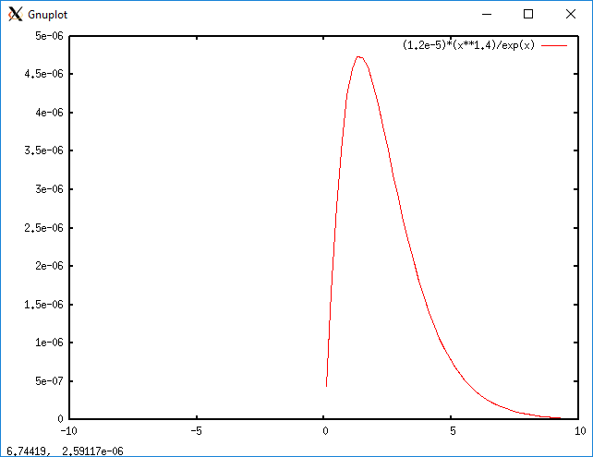
Gnuplot – function plots
2-D variable is x
gnuplot> plot sin(x)
Use replot to display a second function
gnuplot> replot cos(x)
Math functions in fortran style
gnuplot> plot (1.2e-5)*(x**1.4)/exp(x)
Many functions (use ‘help functions’ to list)
e.g. abs() sinh() log() rand() acos() sqrt()

Slide 175

Gnuplot – parametric plots
gnuplot> set parametric
2-D “dummy” variable is t
gnuplot> plot sin(2*t), cos(sqrt(2)*t)
gnuplot> unset parametric

Slide 176

Gnuplot – parametric plots
gnuplot> set size square
gnuplot> r=1
gnuplot> fx(t) = r*cos(t)
gnuplot> fy(t) = r*sin(t)
gnuplot> plot fx(t),fy(t)

Slide 177

Gnuplot – 3D plots
gnuplot> set parametric
gnuplot> r=1
gnuplot> fx(v,u) = r*cos(v)*cos(u)
gnuplot> fy(v,u) = r*cos(v)*sin(u)
gnuplot> fz(v) = r*sin(v)
gnuplot> splot fx(v,u),fy(v,u),fz(v)

Slide 178


Gnuplot – 3D plots
gnuplot> splot "test.dat" u 1:2:3
For 3d graphs splot, the view and scaling of the graph can be changed with mouse buttons

Slide 179

Gnuplot – polar plots
gnuplot> set polar
gnuplot> set size ratio -1
gnuplot> plot 1
gnuplot> unset polar

Slide 180


Gnuplot - data plots
Single channel
gnuplot> plot "test.dat" u 3 w l
gnuplot> plot "test.dat" using 3 with lines

Slide 181

Gnuplot - data plots
Cross plots
gnuplot> plot "test.dat" u 1:2 w l, "test.dat" u 1:3 w p

Slide 182

Gnuplot - settings
gnuplot> plot [:] [10:40] "test.dat" u 1:3 w l
gnuplot> set xlabel 'length(mm)'; set ylabel 'stress(MPa)' -1,0; replot
gnuplot> set title "Sample 1"; set key 15,20; replot
gnuplot> set xtics ('low' 0, 'med' 10,'high' 20); set grid; set format y '%.1e'; replot
Plot with the new settings

Slide 183
Gnuplot - settings
Relative Graph size: > set size 1,1
Function sampling pts: > set samples 1000
Polar Coordinates: > set polar
Contour plots: > set contour base
Perspective: > set view 90,0
Angle Units: > set angles degrees
Style: > set data style lines

Slide 184
Gnuplot – basic functions
command line entry | description of action
exit or quit | Quits gnuplot
help or ? <topic> | help or help on a specific topic
set key or unset key | Adds or removes legend from display
set xrange [a:b] | Controls the range of values on the x axis
plot sin(x**2-1) with points <value> | plots sin(x**2 − 1) lots of in-built math functions <value> between 1 and 8 denotes different pointstyles
plot sin(x) with lines <value> | <value> between 1 and 8 denotes different linestyles
plot ’test.dat’ u 1:2 t ’test’ w l 1,’test.dat’ u 1:3 t ’test’ w p 2 | plots multiple sets of data on same graph: Curve of cols 1 and 2 from <test.dat> plus points from cols 1 and 3 of <test.dat>. The t is an abbr. of title for labelling in the legend
set term postscript set term png | Output in postscript/png file rather than to the display
set output ’filename.eps’ | Sets up an output file for output to go to
replot | redisplays plot with new settings
set term x11 | sets output back to the screen, rather than a file

Slide 185
Gnuplot - settings
place or hide key
set key top center, unset key
set a title
set title "the title"
define axis labels
set xlabel "x [pc]", set ylabel "y [pc]"
change the number format
set format x "%10.3f"
plot an arrow
set arrow from 0.5,0 to 0.5,1
define a label
set label "rarefaction wave" at 0.5,0
set border style
set border lw 3

Slide 186
Gnuplot - settings
color, width and shape of lines/points
linetype / lt, pointtype / pt,
linewidth / lw, pointsize / ps
logscale
[un]set logscale [xy],
select zoom
set xrange [0:10] ... manually selected range of x-axis,
set yrange [*:*] ... select zoom of y-axis automatically,
set autoscale ... select zoom of any axis automatically

Slide 187
Gnuplot
Show command gives current settings
gnuplot> show xlabel
Reset recalls default settings
Save records current settings and plot statement
gnuplot> save ‘/home/mag/test.gp’
Load executes settings from a file
gnuplot> load ‘/home/mag/test.gp’
Help is extremely useful in determining set syntax
gnuplot> help set

Slide 188

Gnuplot - multiplot
set multiplot
set origin 0 ,0
set size 0.5 ,0.5
plot x*x*x t 'x^3'
set origin 0 ,0.5
plot x t 'x'
set origin 0.5 ,0.5
plot x*x t 'x^2'
set origin 0.5 ,0
plot x*x*x*x t 'x^4'
stack several plot commands
set multiplot
scale the plot
set size
place the plot
set origin
leave multiplot mode
unset multiplot

Slide 189

Gnuplot - multiple graphs - y1 and y2 axis
set ytics nomirror
set y2tics 0, 10
set key top center
plot x axis x1y1, x*x axis x1y2

Slide 190
Gnuplot - animations
If you use gnuplot 4.6 you can use a do loop:
If you want to store the snapshots use:
filename(n) = sprintf("file_%d", n)
plot for [i=1:10] filename(i) using 1:2 with lines
In earlier versions you have to place your code in two files and to use “reread”:
File 1: t=0; tmax=18;load "file2.gnuplot"
File 2: t=t+1;outfile = sprintf(’view%03.0f.png’,t);
set view t*5,30,1,1;set output outfile; plot
data.txt; if(t<tmax) reread;

Slide 191
Gnuplot - Fitting data
Define the power law
d(x)=c+a*sqrt(b*x)
Fit your data - - you might need to set initial values for a,b,c
fit d(x) 'cl1d_integrals.dat' u 1:5 via a,b,c
print a,b
plot [0:5000] c+a*sqrt(x*b) t '' w l ‘test1.dat' u 1:5 t '' w l
Drawing error bars
plot ’data.txt’ u 0:1:2:3 w yerrorbars
Uses column 1 as y values, column 2 as lower end of the vertical error bar and column 3 as the upper end of the vertical error bar.
Horizontal error bars are created with xerrorbars

Slide 192

Gnuplot and LaTeX
Gnuplot is easy to produce postscript plots that an be used by scientific publications in LaTeX
Change the terminal type
Possibility to use LaTeX notation
set terminal postscript eps size 3.5,2.62 \ enhanced color font 'Helvetica,30' linewidth 2
set output ‘test.eps'
set xlabel '{/Symbol t}'
set ylabel '{/Symbol d}{/Symbol f}'
unset ytics
set title ''
unset label
set pointsize 2
plot 'test.dat' u 2:3 t ""
reset

Slide 193
Gnuplot and LaTeX
gnuplot> set terminal latex
gnuplot> set output "example1.tex"
gnuplot> plot [-3.14:3.14] sin(x)
Results in example1.tex
% GNUPLOT: LaTeX picture
\setlength{\unitlength}{0.240900pt}
\ifx\plotpoint\undefined\newsavebox{\plotpoint}\fi\
begin{picture}(1500,900)(0,0)
\sbox{\plotpoint}{\rule[-0.200pt]{0.400pt}{0.400pt}}%
\put(170.0,82.0){\rule[-0.200pt]{4.818pt}{0.400pt
…
\put(170.0,860.0){\rule[-0.200pt]{308.352pt}{0.400pt}}\end{picture}

Slide 194

Gnuplot and LaTeX
LaTeX document:
\documentclass{article}
\usepackage{geometry}
\usepackage{color}
\usepackage{graphicx}
\begin{document}
\begin{figure}
\begin{center}
\include{example1}
\end{center}
\caption{A caption}
\end{figure}
\end{document}

Slide 195
ImageMagick
ImageMagick (http://www.imagemagick.org) is a powerful, free software suite to create, edit, and compose bitmap images. It can read, convert and write images in a large variety of formats.

Slide 196
ImageMagick - Tools
Convert
Convert image formats.
Many image transformations available – scale, rotate, text, artistic filters
Display
Import
Screen capture under Linux
Identify
Find out characteristics of image
Composite
Composite multiple images together

Slide 197
ImageMagick - processing
Add a blue border around image (expand?, replace?, shrink?)
convert -border 10x10 -bordercolor "#6699ff" fan.png fan2.png
Add a caption/attribution
convert -font helvetica -fill red -pointsize 14 -draw 'text 446,404 "made by……"' fan2.png fan3.png

Slide 198
ImageMagick - movies
ImageMagick can create animations (animated GIFs only)
convert -delay 20 –loop 0 file*.png anim.gif
animate anim.gif

Slide 199
ImageMagick - actions
feature | action
Animation | create a GIF animation sequence from a group of images.
Color management | accurate color management with color profiles or in lieu of-- built-in gamma compression or expansion as demanded by the colorspace
Composite | overlap one image over another
Decorate | add a border or frame to an image.
Discrete Fourier Transf. | implements the forward and inverse DFT.
Draw | add shapes or text to an image.
Format conversion | convert an image from one format to another (e.g. PNG to JPEG).
Generalized pixel distortion | correct for, or induce image distortions including perspective.
Image calculator | apply a mathematical expression to an image or image channels.
Image gradients | create a gradual blend of two colors whose shape is horizontal, vertical, circular, or elliptical.
Image identification | describe the format and attributes of an image.
Transform | resize, rotate, deskew, crop, flip or trim an image.
Transparency | render portions of an image invisible.

Slide 200


ImageMagick - examples
https://www.imagemagick.org/script/examples.php

Slide 201


ImageMagick - examples
https://www.imagemagick.org/script/examples.php

Slide 202
ImageMagick – batch processing
Batch processing -> working with a set or sequence of images
All images generally must be the same size
Change colors:
convert -colorspace Gray example01.png example001.png
Resize:
convert -scale 20%% example01.png example001.png
Add a caption:
convert -size 320x85 -draw "text 25,60 'Made by....'" -fill darkred example01.png example001.png
Process all files:
for file in *.png ;do convert -colorspace Gray $file ${file%.png}.jpg; done

Slide 203
Hands-on 4

Slide 204
Plot 10 png images in gnuplot. The first one should show 1 circle, next ones should add and an extra circle with increased radius.
Convert the images to grayscale and save them into *.jpg file
Make an animated gif
Open animation (in the web browser or file browser)

Slide 205
#! /usr/bin/gnuplot
set polar
set size square
set term png
set xrange [-10:10];set yrange [-10:10]
r=1
do for [r=1:10] {
outfile = sprintf('radius%02.0f.png',r)
set output outfile
plot for [i=0:r-1] r-i
}
for file in *.png ;do convert -colorspace Gray $file ${file%.png}.jpg; done or manually:
convert -colorspace Gray radius.01.png radius.01.jpg
….
convert -delay 20 *png radius.gif
…..

Slide 206
Questions
Now
Helpdesk: hpcinfo@kuleuven.be or https://admin.kuleuven.be/icts/HPCinfo_form/HPC-info-formulier
VSC web site: http://www.vscentrum.be/
VSC documentation: https://docs.vscentrum.be/ VSC agenda: training sessions, events
Systems status page: http://status.kuleuven.be/hpc

Slide 207
VSC training
Info sessions:
Containers
Notebooks
Jupyterhub
Matlab Supercalculator
Matlab programming
Linux scripting
Introductory
Intermediate
Advanced
Specialist track
Linux for HPC
Linux
HPC intro
worker/atools
Linux tools
CMake intro
Make intro
Version control with Git
Python as a second language
Python: System programming
Scientific Python
Python for Software engineering
Python for data science
Python for machine learning
C
C++ for scientific computing
Fortran for programmers
Python for HPC
OpenMP
Debugging techniques
MPI
Code optimization
?
PRACE MOOC Defensive programming and debugging and Fortran programming
Stay up-to-date https://www.vscentrum.be/training

Slide 208

Wait a minute…

Slide 209
Replacement Patterns
Substitute can use several special characters in the replacement string
& replaced by the entire string matched in the regular expression for pattern
\n replaced by the nth substring (or subexpression) previously specified using “\(“ and “\)”
\ used to escape the ampersand (&) and the backslash (\)

Slide 210
Replacement Pattern Examples
"the UNIX operating system …"
s/.NI./wonderful &/
--> "the wonderful UNIX operating system …"
$ cat test1
first:second
one:two
$ sed 's/\(.*\):\(.*\)/\2:\1/' test1
second:first
two:one
"unix is fun“
sed 's/\([[:alpha:]]\)\([^ \n]*\)/\2\1ay/g'
--> "nixuay siay unfay"

Slide 211

Example

Slide 212

Another Example
Adding 12 points to everyone’s midterm score

Slide 213
A simple example
Problem : Get the userid of user “arun” from the /etc/passwd file.
Suppose /etc/passwd file contains the following entries
arun:x:504:504::/home/arun:/bin/bash
try:x:500:500::/home/try:/bin/bash
optima:x:501:501::/home/optima:/bin/bash
optimal:x:502:502::/home/optimal:/bin/bash
awk will see this file as follows
1 line = 1 record (by default) so in total there are 4 records in the file.
1 record = 7 fields separated by “:” (Not by default)
Note : Default field separator is space.

Slide 214
Advanced awk features (cont..)
Common Arithmetic operators in awk are : “+", “-", “/", “*“;
“^” is the exponentiation operator.
“%” is the modulo operator
All the C operators like “++”, “--”, “+=“, “-=”, “/=“ etc. are also valid.
The awk language has one-dimensional arrays for storing groups of related strings or numbers.
Arrays in awk are associative. This means that each array is a collection of pairs: an index, and its corresponding array element value.
(eg) : Element 1 value 2
Element 2 value “foo”
Element “cat” value “chicken”

Slide 215
awk '{ if (NF > max) max = NF }

Slide 216
Example: explicit match
$ cat datafile
northwest NW Charles Main 3.0 .98 3 34
western WE Sharon Gray 5.3 .97 5 23
southwest SW Lewis Dalsass 2.7 .8 2 18
southern SO Suan Chin 5.1 .95 4 15
southeast SE Patricia Hemenway 4.0 .7 4 17
eastern EA TB Savage 4.4 .84 5 20
northeast NE AM Main 5.1 .94 3 13
north NO Margot Weber 4.5 .89 5 9
central CT Ann Stephens 5.7 .94 5 13
$ awk '$5 ~ /\.[7-9]+/' datafile
southwest SW Lewis Dalsass 2.7 .8 2 18
central CT Ann Stephens 5.7 .94 5 13

Slide 217
Examples: matching with REs
% awk '$2 !~ /E/{print $1, $2}' datafile
northwest NW
southwest SW
southern SO
north NO
central CT
% awk '/^[ns]/{print $1}' datafile
northwest
southwest
southern
southeast
northeast
north

Slide 218
print Example
% date
Wed Nov 19 14:40:07 CST 2008
% date |
awk '{print "Month: " $2 "\nYear: ", $6}'
Month: Nov
Year: 2008
CSCI 330 - The UNIX System
Notes:
The AWK/NAWK Utility
Copyright Department of Computer Science, Northern Illinois University, 2004
218

Slide 219
awk Example: list of products
103:sway bar:49.99
101:propeller:104.99
104:fishing line:0.99
113:premium fish bait:1.00
106:cup holder:2.49
107:cooler:14.89
112:boat cover:120.00
109:transom:199.00
110:pulley:9.88
105:mirror:4.99
108:wheel:49.99
111:lock:31.00
102:trailer hitch:97.95

Slide 220
awk Example: output
Marine Parts R Us
Main catalog
Part-id name price
======================================
101 propeller 104.99
102 trailer hitch 97.95
103 sway bar 49.99
104 fishing line 0.99
105 mirror 4.99
106 cup holder 2.49
107 cooler 14.89
108 wheel 49.99
109 transom 199.00
110 pulley 9.88
111 lock 31.00
112 boat cover 120.00
113 premium fish bait 1.00
======================================
Catalog has 13 parts

Slide 221
awk Example: complete
BEGIN {
FS= ":"
print "Marine Parts R Us"
print "Main catalog"
print "Part-id\tname\t\t\t price"
print "======================================"
}
{
printf("%3d\t%-20s\t%6.2f\n", $1, $2, $3)
count++
}
END {
print "======================================"
print "Catalog has " count " parts"
}
is output sorted ?

